Slide 1
MATERIAL SYNTHESIS SQUID

Slide 2
SQUID(Superconducting Quantum Interference Device
→A SQUID (superconducting quantum interference device) is a very sensitive magnetometer used to measure extremely weak magnetic fields, based on superconducting loops containing Josephson junctions.
→SQUIDs are sensitive enough to measure fields as low as 5×10−14 T.
→There are two main types of SQUID they are:
direct current (DC) ,&
radio frequency (RF).

Slide 3
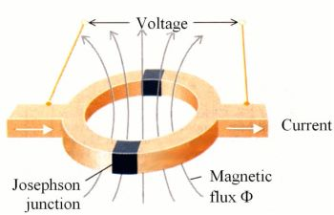
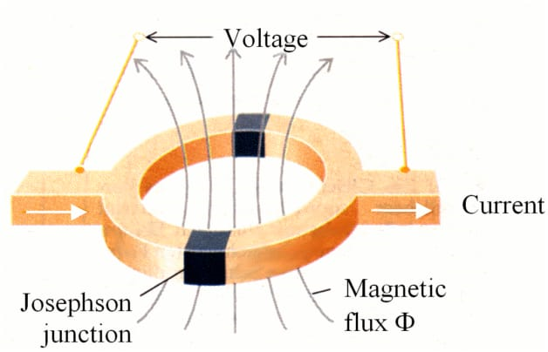
Josephson Junctions
→A SQUID consists of a loop with two Josephson junctions interrupting the loop.
→SQUID is a mechanism for measuring extremely weak signals in Josephson junction.
→The operation of a SQUID magnetometer is based on two effects flux quantization and the Josephson effect.

Slide 4
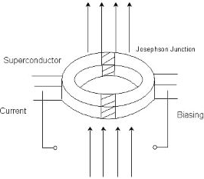
.
→The classical Josephson junction consists of an insulating barrier between two superconductors thin enough to couple “weakly.”
→There are two types of SQUID, the radio frequency (RF) SQUID consisting of only one Josephson junction, and the direct current (DC) SQUID with two or more junctions.
→The RF is cheaper in construction but less sensitive compared to the DC.

Slide 5
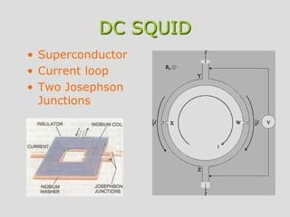
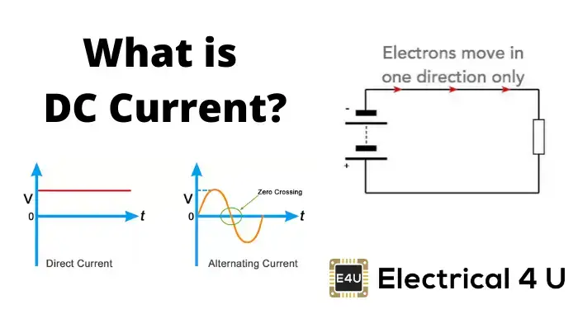
Direct Current (DC)
we pass a constant current, known as a bias current, through the SQUID. If the SQUID is symmetrical and the junctions are identical, the bias current will split equally, half on each side.

Slide 6
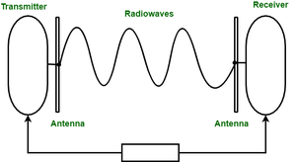
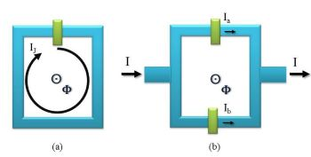
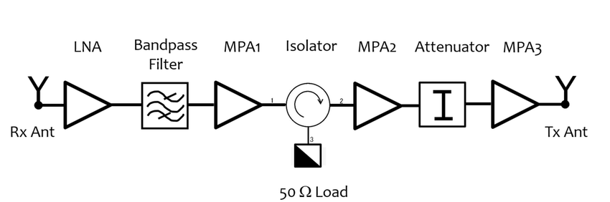
Radio Frequency (RF)
The RF (Radio Frequency) SQUID is a one-junction SQUID loop that can be used as a magnetic field detector

Slide 7
Application
A SQUID is a very sensitive magnetometer used to measure extremely weak magnetic fields, based on superconducting loops containing Josephson junctions.
SQUIDs are sensitive enough to measure fields as low as 5×10−14 T with a few days of averaged measurements.
SQUIDs are used in superparamagnetic relaxometry (SPMR), a technology that utilizes the high magnetic field sensitivity of SQUID sensors and the superparamagnetic properties of magnetite nanoparticles.

Slide 8
Uses
→SQUID magnetometers are generally used to measure the magnetization of very small samples (e.g., thin films) or systems that are just on the limit of magnetic order.
→Therefore, SQUID magnetometers are mainly applied to scientific investigations.

Slide 9
Thankyou…

